Slide 1
Using Data to Develop Practice Setting-Specific Benchmarks for Family Medicine Paul James MD
University of Iowa

Slide 2
My Problems and how is this Research? “Truth, Justice and the American Way”
Our faculty are paid salary based on exceeding mean RVU benchmark for discipline
Dean’s office/hospital forced a shift to metrics using FPSC data (subsidiary of AAMC -UHC)
RVU targets: EXTREMELY important to faculty
Payment of our doctors needs to be competitive

Slide 3
FPSC Work RVU Benchmarks for Family Medicine Perceived as High
FPSC benchmarks provide single composite measure inclusive of practice in the following settings
Resident clinic
Non-resident clinic
Inpatient attending service
Practice setting has a measurable impact on productivity, with production in the resident clinic setting being highest and inpatient attending being lowest
ADFM community has expressed interest in developing practice setting-specific benchmarks

Slide 4
FPSC Contains Data for 87 Departments of Family Medicine Nationwide, Representing 5,884 Physicians
Participants send physician-level billing data to FPSC. Data is electronically extracted and sent from the billing office.
Data In (at the procedure-level):
Total Billings for ea. Procedure
Site of Service for ea. Procedure
CPT Code for the Procedure
Payer Class for ea. Procedure
CPT Code Modifiers
ICD-9 Codes (first four)
Frequency of Billed Procedure
Patient MRN
Patient Demographics Data: age, sex, race, zip code

Slide 5
UHC-AAMC FPSC Members
Albany Medical Center
Baylor College of Medicine
Baystate Health System
Beaumont Physician Partners
Beth Israel-Deaconess Medical Center (Harvard)
Brigham & Women’s Physician Organization
Cedars-Sinai Medical Center
Clarian Health
ColumbiaDoctors
Dartmouth Hitchcock Medical Center
Denver Health
Duke University Medical Center, Private Diagnostic Clinic
East Carolina University Physicians
Georgetown University Medical Center
Howard University Faculty Practice Plan
Henry Ford Health System
Indiana University Medical Group
Johns Hopkins University Clinical Practice Association
Kansas University Physicians
Kentucky Medical Services Foundation
LifeBridge Health – Sinai Hospital of Baltimore
Loyola University Physician Foundation
LSU Healthcare Network
Massachusetts General Physicians Organization
Medical College of Georgia Physicians Practice Group
Medical College of Wisconsin, Medical College Physicians
Medical University of South Carolina, University Medical Associates
Montefiore Medical Center
Morehouse Medical Associates
Mt. Sinai Faculty Practice Associates
Northwestern Medical Faculty Foundation
Ohio State University Physicians, Inc.
Oregon Health and Science University, University Medical Group
Rush University Medical Group
Saint Louis University, SLUCare
Southern Illinois University
Stanford University School of Medicine
SUNY Stony Brook, Clinical Practice Management Plan
SUNY Upstate Medical University, University Medical Associates at Syracuse, Inc.
The Emory Clinic, Inc.
Thomas Jefferson University, Jefferson University Physicians
Tufts Medical Center
Tulane University Medical Group
University of Alabama Health Services Foundation
University Physicians Healthcare (Arizona)
University of Arkansas School of Medicine
UC Davis Medical Group
UCLA Faculty Practice Group
UCSD Medical Group
UCSF Medical Group
University of Chicago Medical Center
University of Cincinnati Physicians, Inc.
University Physicians, Inc. (Colorado)
University of Connecticut Medical Group
University of Florida Faculty Group Practice
University of Illinois College of Medicine
University of Iowa Physicians
University Physicians Associates (Louisville)
University Physicians, Inc. (Maryland)
UMass Memorial Medical Group
University of Miami Medical Group
University of Michigan School of Medicine Faculty Group Practice
University of Minnesota Physicians
University of MS Faculty Practice Plan
University of Missouri – Columbia, University Physicians
University of Missouri – Kansas City, University Physicians Associates
University of Nebraska Medical Center Physicians
University of New Mexico Medical Group
University of North Carolina at Chapel Hill Physicians and Associates
University of Oklahoma, OU Physicians
University of Pennsylvania Health System
University of Rochester School of Medicine
University of South Florida Physicians Group
Keck School of Medicine at USC
UTMB, Galveston
University of Tennessee Medical Group
University of Texas San Antonio
University of Toledo Physicians, LLC
University Health Care, University of Utah Medical Group
University of Vermont, Fletcher Allen Health Care
University of Virginia Heath Services Foundation
University of Washington School of Medicine
University of Wisconsin Medical Foundation
Vanderbilt Medical Group
VCU Health System / MCV Physicians
Wake Forest University Physicians
West Virginia University Medical Corporation, University Health Associates
Weill Cornell Physician Organization
Yale Medical Group

Slide 6
Single Algorithm to Assign RVUs Ensures Apples-to-Apples Comparability
Standard source data for applying RVUs
Single approach to gap fill for CPT codes without Medicare-assigned RVUs
Consistent adjustment of RVUs for modifiers, including multiple surgical procedures and multiple endoscopies

Slide 7
Supplemental Info Needed to Develop Practice Setting-Specific Benchmarks
In addition to already collected data, the following data points are needed at the physician level:
Number of ½ day clinic sessions worked per week
Without residents
With residents
Number of weeks per year scheduled for inpatient attending service
Optional demographic elements:
Academic rank
Other

Slide 8
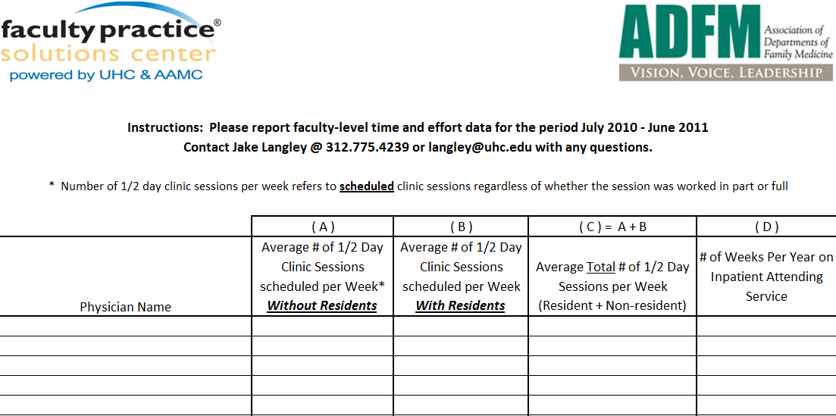
Sample Template for Supplemental Data Collection
Collecting # of clinic sessions and weeks on inpatient service will allow us to break down cFTE into an inpatient and outpatient measure

Slide 9
Converting Clinic Sessions and Weeks on Service to cFTE
Clinic sessions
Number of half day sessions per week / 9
EX: 4 clinic sessions per week = 0.44 cFTE
Inpatient service
# of days per year / 7 days* / 44 weeks**
EX: 42 days / 7 / 44 = 6 wks per year
* days considered a full week of service; can vary
by nature of service
** year can be defined as 42, 44, or 46 weeks; model based on 44
2 resident clinic sessions / wk =0.22
2 non-res clinic sessions / wk = 0.22
42 days on inpatient service = 0.14
TOTAL cFTE = 0.58
Is there an opportunity for the Family Medicine community to develop a consensus cFTE definition?

Slide 10
Example Application of Model: Selected University of Iowa Family Medicine MDs
Physician | Non – Resident Clinic Sessions | Non – Resident cFTE | Resident Clinic Sessions | Resident cFTE | Annual Days on Inpatient Service | Inpatient cFTE*
A | 1 | 0.11 | 0.5 | 0.06 | 35 | .12 / .11 / .11
B | 1 | 0.11 | 1 | 0.11 | 49 | .17 / .16 / .15
C | 4 | 0.44 | 2 | 0.22 | 52 | .18 / .17 / .16
D | 4 | 0.44 | 2 | 0.22 | 63 | .21 / .20 / .20
E | 2 | 0.22 | 2 | 0.22 | 35 | .12 / .11 / .11
F | 3 | 0.33 | 2 | 0.22 | 47 | .16 / .15 / .15
* Figures represent year of 42/44/46 weeks

Slide 11
Iowa Practice Setting-Specific Productivity Rates
Physician | Non-resident Clinic wRVUs | wRVUs per cFTE Non-resident Clinic | Resident Clinic wRVUs | wRVUs per cFTE Resident Clinic | Inpatient wRVUs | 1.0 cFTE wRVUs - 44 week work year
A | 691.8 | 6,225.9 | 667.0 | 12,006.5 | 287.7 | 1,917.7
B | 717.0 | 6,452.9 | 452.8 | 4,074.8 | 943.2 | 5,928.9
C | 1,901.7 | 4,278.8 | 1,821.5 | 8,196.6 | 1,756.3 | 7,430.5
D | 2,035.2 | 4,579.1 | 1,588.1 | 7,146.4 | 1,133.8 | 5,543.2
E | 1,711.8 | 7,703.0 | 1,569.5 | 7,062.6 | 399.6 | 2,512.0
F | 1,216.2 | 3,648.7 | 1,593.8 | 7,172.3 | 945.4 | 6,195.6
Average* | -- | 6,625.3 | -- | 8,008.9 | -- | 4,703.1
Practice setting-specific 1.0 cFTE wRVUs are calculated by dividing a physician’s raw setting-specific wRVUs by their setting-specific cFTE
*Represents U of Iowa’s DFM average, only selected MDs shown above

Slide 12
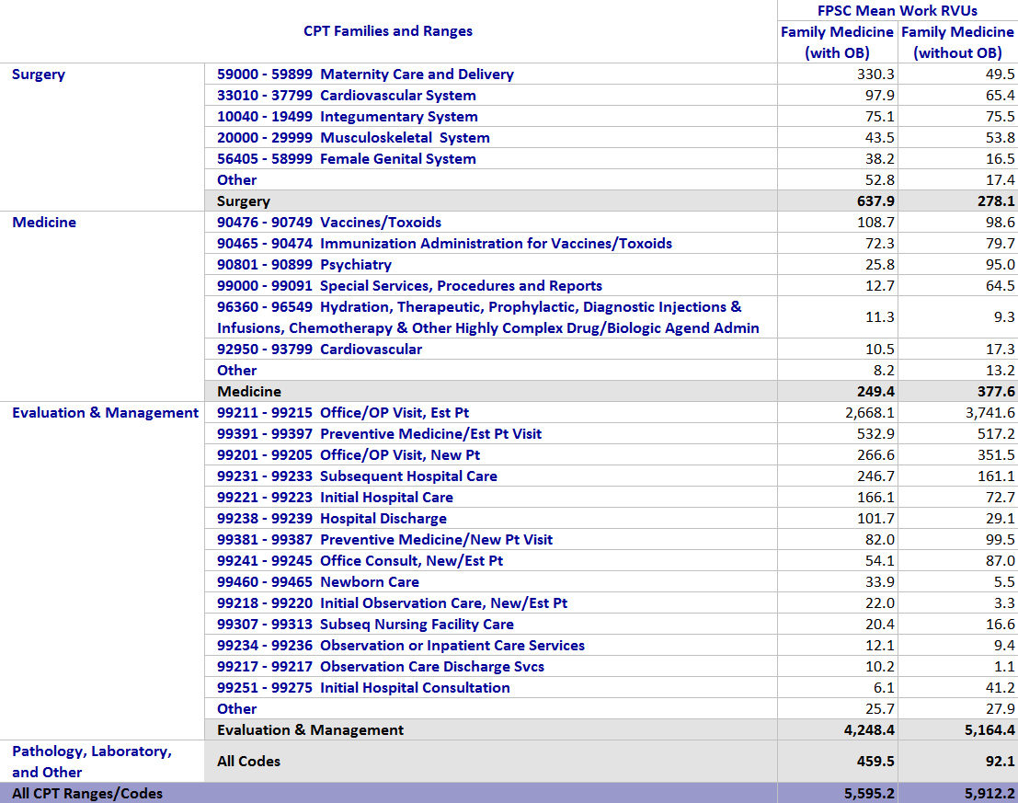
Understanding Family Medicine Benchmarks Using the FPSC “Clinical Fingerprint”

Slide 13
Opportunities to Use the FPSC in Departments of Family Medicine
Increase the Yield of Clinical Practice
Understand the Impact of Policy Initiatives
Measure E&M coding distributions, with an eye to avoiding potential under-coding
Assess potential missed charge capture
Optimize visit and service mix
Improve the revenue cycle
Gauge eligibility for Primary Care & e-Prescribing incentives from Medicare
Assess eligibility for incentives related to Meaningful Use of HIT
Monitor impact of changes to the Medicare Physician Fee Schedule
Measure potential impact of Medicare eliminating the split billing differential

Slide 14
What have I learned?
We in family medicine may have a compensation problem more than we have an RVU metric problem.
Data (information) is valuable when it is true and tested
We need to engage with FPSC so that we understand our data and can better communicate with institutional leaders

Slide 15
Can my DFM work with FPSC to better understand our data? YES!
Some departments are already a part of a pilot group and can continue their involvement
Return your supplemental data to the FPSC if you have not already done so
Once the supplemental data are received, the FPSC will work with your department on validation
If you were not a part of the pilot group but would like to be involved, contact the FPSC
You will be provided with a customized data collection template for your practice
The broader the participation within the Family Medicine community, the more robust the final data will be
FPSC would be happy to invite you to their offices in downtown Chicago for hands-on training, to learn how to use these data in conjunction with other FPSC tools to optimize practice management within your departments

Slide 16
Questions?
Contact:
Paul James, MD
Professor and Head, Dept. of Family Medicine, University of Iowa
319-384-7500
paul-james@uiowa.edu
Bob Browne
Vice President, Physician Services, UHC
312-775-4132
browne@uhc.edu
Jake Langley
Analyst, Physician Services, UHC
312-775-4239
langley@uhc.edu

