Slide 1
Competency-Based Medical Education
Notes:
Thank you for inviting me to be here today. You’ll recall that in February Dr Montgomery provided outcomes of a January CBME Summit and an overview of foundational work being done by STFM to help residency programs meet new ACGME requirements for competency based medical education. Today, I’m going to tell you where we are with that foundational work, and talk about our proposal for the next stages of work. I’d welcome your thoughts on the direction we’re headed.

Slide 2
Background:
In August 2022, the ABFM Foundation awarded STFM a grant to support the development phase of a multi-year project to equip residency programs to deliver competency-based education and assessment.
STFM committed to:
Conducting a consensus-building Summit
Launching a task force to develop strategies and resources to improve CBME
Updating existing STFM faculty development resources
Notes:
In very brief review, the ABFM foundation funded a 17 month development grant and STFM committed to do those three things – conduct a summit, launch a task force, and update existing STfM faculty development resources. We’re well on our way to completing all of these, and are confident they’ll be wrapped up by the end of the 17 months, which is October 2023.

Slide 3
STFM Task Force
Assessments
& Assessment Technology Work Group
Resident Involvement & Individualized Learning Plans Work Group
Faculty Development & Pilot Project Work Group
Notes:
Since Dr Montgomery’s February update, our Task Force created these three work groups --- We have had one in person and one virtual meeting of the whole Task Force and lots of work group meetings and accomplished a lot of work which I’ll go through briefly with you.

Slide 4
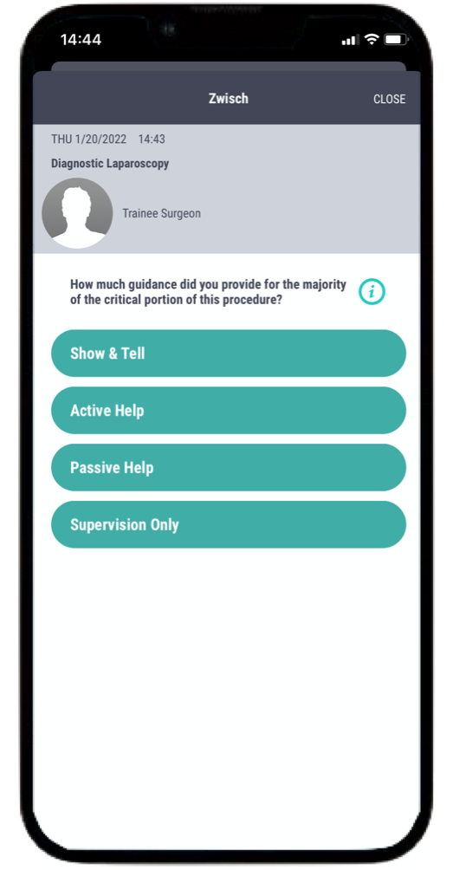
Assessments & Assessment Technology
Vetted assessment apps and made a recommendation for real-time
assessment of residents
Determining how the app can be used to
assess residents on some or all of the
Core Outcomes
Identifying what assessments could
also be used in addition to the app
Notes:
The first group is working on assessments and assessment technology, and were specifically assigned these three tasks. They vetted several assessment apps and made a decision on which one family medicine should focus on for real-time assessment of residents. The plan is to work with initially with New
Innovations for the first stage of development for real-time assessment of residents. I’ll talk more about this in a minute.
Τηε σεχονδ ασσιγνεδ τασκ ωασ το determine how the app can be used to assess residents on some or all of the Core Outcomes. This is in progress. We’ve actually had one call with representatives from Pediatrics and Surgery to talk about how they’re using their apps, and how and if they’re connecting their assessment
questions to their EPAs and Milestones. A second call will take place sometime in the next month. It has been decided that the family medicine app will use an entrustment scale, as the others do.
Τηε ωορκ γρουπ ισ αλσο identifying what assessments should be used in addition to the app. There have been conversations about this in broad terms, looking at what’s been recommended by the ACGME and Dr Newton. The group is still working on specifics.

Slide 5
Resident Involvement /ILP Development
Mapping the ACGME/ABFM Core Outcomes to the Milestones/Subcompetencies
Reviewed ILPs currently in use
Developing components of an online ILP that can be created and used by family medicine residencies
Identifying strategies for including residents in their own ILP development
Notes:
The second group is focused on resident involvement and ILP development.
They are mapping the ACGME/ABFM Core Outcomes for Family Medicine Residency Training to the ACGME
Family Medicine Milestones/Subcompetencies. The first draft is complete. The task force meets next week and will likely finalize a document that can be shared. The Core Outcomes are
also being mapped to the Osteopathic Milestones.
• Τηε ωορκ γρουπ reviewed ILPs currently in use and developed components of an online ILP that can be used widely by family medicine residencies. The ILP is currently in Microsoft Word format. It is being tested with a few residencies and will be reformatted and shared more broadly over the coming months.
Ανδ, φιναλλψ, τηισ ωορκ γρουπ ισ identifying strategies for including residents in their own ILP development (Opportunities are built into the ILP for this, and the task force is planning for online and virtual training in the next phase of work.)

Slide 6

Faculty Development and Pilot Project
Created a plan for faculty and resident development
Created a plan for piloting new assessments and assessment approaches
Created a plan for disseminating faculty development and resources
Notes:
And these were the tasks assigned to the faculty development and pilot project work.—These plans are complete and incorporated in our next funding proposal.

Slide 7
And more…
National Recommendations for Implementation of CBME in Family Medicine
Notes:
And then a little bonus…. It was not in task force charge but inspired by the Joint Guidelines for Protected Nonclinical Time that appeared in Family Medcine and emboldened by our own growing expertise in CBME, our Task Force decided to create evidence-based recommendations for implementing CBME.
We’ll talk more about these more, a bit later in the meeting

Slide 8
What the task force is working on now:
All Groups:
  Submissions to STFM Annual Spring Conference and AAFP Residency Leadership Summit
  National Recommendations for Implementation of CBME
  Milestone Mapping
Assessment Group:
  Finding a connection to New Innovations
  Assessment questions for the mobile app and a process to get wider input
  Guidance and tools programs can use now for CBME assessment
Resident Engagement Group:
  Guidance on resident portfolios for CBME
Faculty Development Group:
  Fall 2023 webinar on CBME basics for programs
Notes:
This is a long list of things our task force continues to work on . In summary we continue to work on assessments, an online toolkit, and national recommendations. We’ve been focused over the last couple of weeks on submissions for the Residency Leadership Summit and the STFM Annual Spring Conference. We’re also developing a webinar that will be presented later this year. The webinar will cover foundational concepts of CBME and also talk about the resources the task force is creating.
The task force meets next week and again in October.

Slide 9
Next Steps
Notes:
We’ve developed a proposal for the next stages of work. An abbrieviated version of our full proposal is in your agenda materials. The STFM Board provided feedback last week, and today we’d welcome feedback from all of you. A final version will submitted to the ABFM Foundation along with a request for funding.

Slide 10
CBME: Phase 2
New proposal for two-year project
Objective: Support family medicine residency programs in their transition to competency-based medical education
Notes:
Here are the basics – We’ve created a proposal for a two-year project.
And unlike the first project which was around foundational development, this one is around helping programs implement CBME education and assessment.

Slide 11
CBME: Phase 2
From September 2023 through August 2025, STFM will, in concert with other organizations,:
  Work with a technology vendor to develop and help residency programs implement a mobile app to record observations of residents
  Train faculty on CBME strategies and tools
  Support development of a CBME Residency Learning Network
  Conduct a pilot project
Notes:
The proposal implements these four tactics

Slide 12

Tactic 1: Work with a technology vendor
Notes:
Tactic #1 is to work with a technology vendor to develop and help residency programs implement a mobile app. The vendor that our assessement work group is most optimistic about is New Innovations due to penetration into residencies and a variety of other reasons. The assessment questions that we develop will be shared so other app vendors or individual residency programs could potentially create assessments using other technology.

Slide 13
Tactic 2: Train family medicine faculty and residents
Conference presentations (Precon at STFM Annual by 2025)
Webinar series/town halls
Adding CBME in more STFM content
  through Faculty Development Delivered
  through CBME experts in STFM’s Learning Network’s Speaker’s Bureau
  through publications
Notes:
Also looking at a presentation for residents at National Conference on ILPs

Slide 14

Tactic 3: Support the development of an STFM CBME Collaborative
Notes:
At the ACGME CBME training session, participants expressed interest in developing an STFM CBME Collaborative. STFM will reach out to participants to identify leaders, define a governance structure and learning objectives, and help coordinate the initial meetings. All STFM members, including those in the pilot project (see Tactic 4) will be invited to join.

Slide 15
Tactic 4: Pilot project
Program directors and residency coordinators from up to 25 residency programs
One 2-day in-person session, one 1-day in-person session, and five virtual training/collaboration sessions
Implement the New Innovations mobile app, the STFM ILP, other assessments and strategies
IRB-approved study of the effectiveness of this training
Notes:
And tactic #4 will be a pilot project – This will include an open call for up to 25 programs to participate in virtual and in person CBME training, and implementation of resources, including the mobile app and LP template. This will be an IRB- approved study of the effectiveness of the training and tools.

Slide 16
Questions?
Feedback on
Next Steps?

