Slide 1
Residency Learning Networks

Slide 2
Background
In December 2022, the ABFM Foundation awarded STFM a 10-month grant to inform and provide leadership for future development of residency learning networks.
Funding for STFM to:
Conduct a Summit to gather input on needs
Implement Residency Learning Network Leadership Training
Create an Action Plan for developing infrastructure for residency learning networks
Notes:
In very brief review, the ABFM Foundation awarded STFM a grant that runs January 2023 through October 2023to inform and provide leadership for future development of residency learning networks. Specifically, the grant provided funding for STFM to:
Conduct a Summit to gather input on needs for residency learning networks and perspectives on various types of and structures of successful learning networks
Create an Action Plan for developing infrastructure for residency learning networks
Implement Residency Learning Network Leadership Training for faculty, PDs, and/or APDs who have an interest in leading Residency Learning Networks
These projects are completed or in progress. An abbreviated version of the Action Plan is in your agenda materials and is what we’re asking for your input on today,

Slide 3
Residency Network
Leadership Training
A preconference workshop at the 2023 Conference on Practice and Quality Improvement.
Attendance at the 2023 Conference on Practice and Quality Improvement, with attendance required at specific sessions that will contribute to effective leadership of learning networks
Notes:
I’m going to start with the leadership training, even thought the Summit came frist. In April of 2023, STFM put out a call for applications for Residency Learning Network Leadership Training for faculty, PDs, and/or APDs who have an interest in leading Residency Learning Networks. 47 individuals applied; 23 were accepted; 21 confirmed. We have faculty finalizing the curriculum now. Corey Lyon, Gretchen Irwin, Stephen Wilson, and Jay Fetter

Slide 4
Residency Network
Leadership Training
Learning collaborative models and definitions
Effective leadership
Change management
Defining and measuring outcomes
Network facilitation
Accessing resources
Securing funding
Notes:
In April of 2023, STFM put out a call for applications for Residency Learning Network Leadership Training for faculty, PDs, and/or APDs who have an interest in leading Residency Learning Networks. 47 individuals applied; 23 were accepted; 21 confirmed.

Slide 5

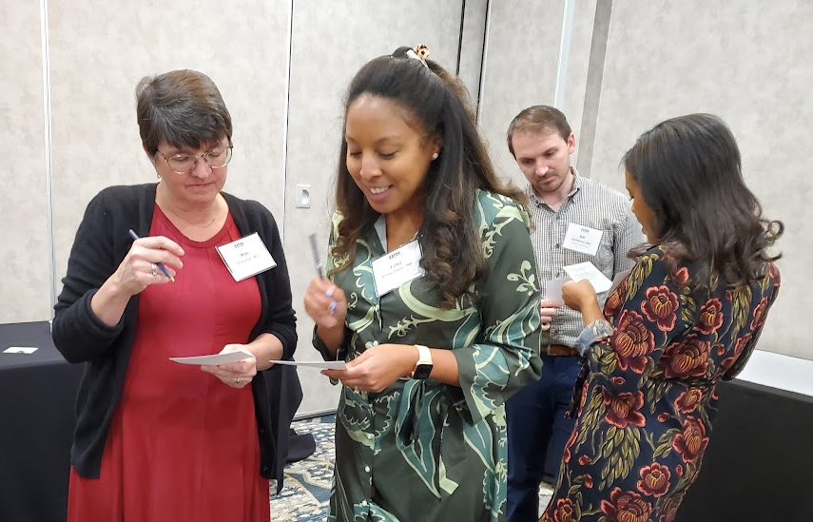
Residency Learning Network Summit
Notes:
Thirty-three individuals met at a Summit in April to clarify needs and generate ideas for an infrastructure for STFM-supported residency learning networks. Participants included organizational representatives, learning collaborative representatives, program directors, faculty, coordinators, and residents. The Summit included a panel discussion on program needs; presentations on eight existing learning network models; and activities, facilitated discussion, and breakout groups to define the level and type of support needed by family medicine residency programs.

Slide 6
General takeaways from Summit:
Because learning networks aren’t a citable ACGME requirement, the messaging about the benefits of joining a network are important.
There are many benefits to joining a learning network; programs should be participating.

Slide 7
Need identified at the summit
“An ideal STFM Learning Network structure would be one where there would be a central resource connecting programs to existing learning collaboratives and providing resources (infrastructure and potentially staffing) to support the development of new networks. As part of this, STFM would host regular meetings of learning network leaders to support cross pollination of best practices across learning networks.”
Notes:
So, that is the focus of our new proposal

Slide 8
What’s in the action plan?
Educate and engage residency programs not currently participating in learning networks
Provide infrastructure and support to new and/or transitioning residency learning networks
Create online resources to support learning networks
Develop leaders of residency learning networks
Notes:
The action plan includes four broad tactics, outlined there. I’m not going to read all the individual tactics to you, as you have those in your materials. Some of the highlights include faculty development through a variety of channels. We’ll provide one-on-one support for those who are trying to create or enhance networks. Support would include staff who could help with advice on creating goals and sustainable governance structures, defining staffing needs, and creating effective meeting communications, agendas, and minutes. We’d also provide peer coaches, who have experience with learning networks, who could help with things like recruitment and engagement, PI projects, data collection and storage. Online resources would include a step by step guide. And we’d continue the leadership training we’ve already starting, training a 2nd cohort of leaders

Slide 9
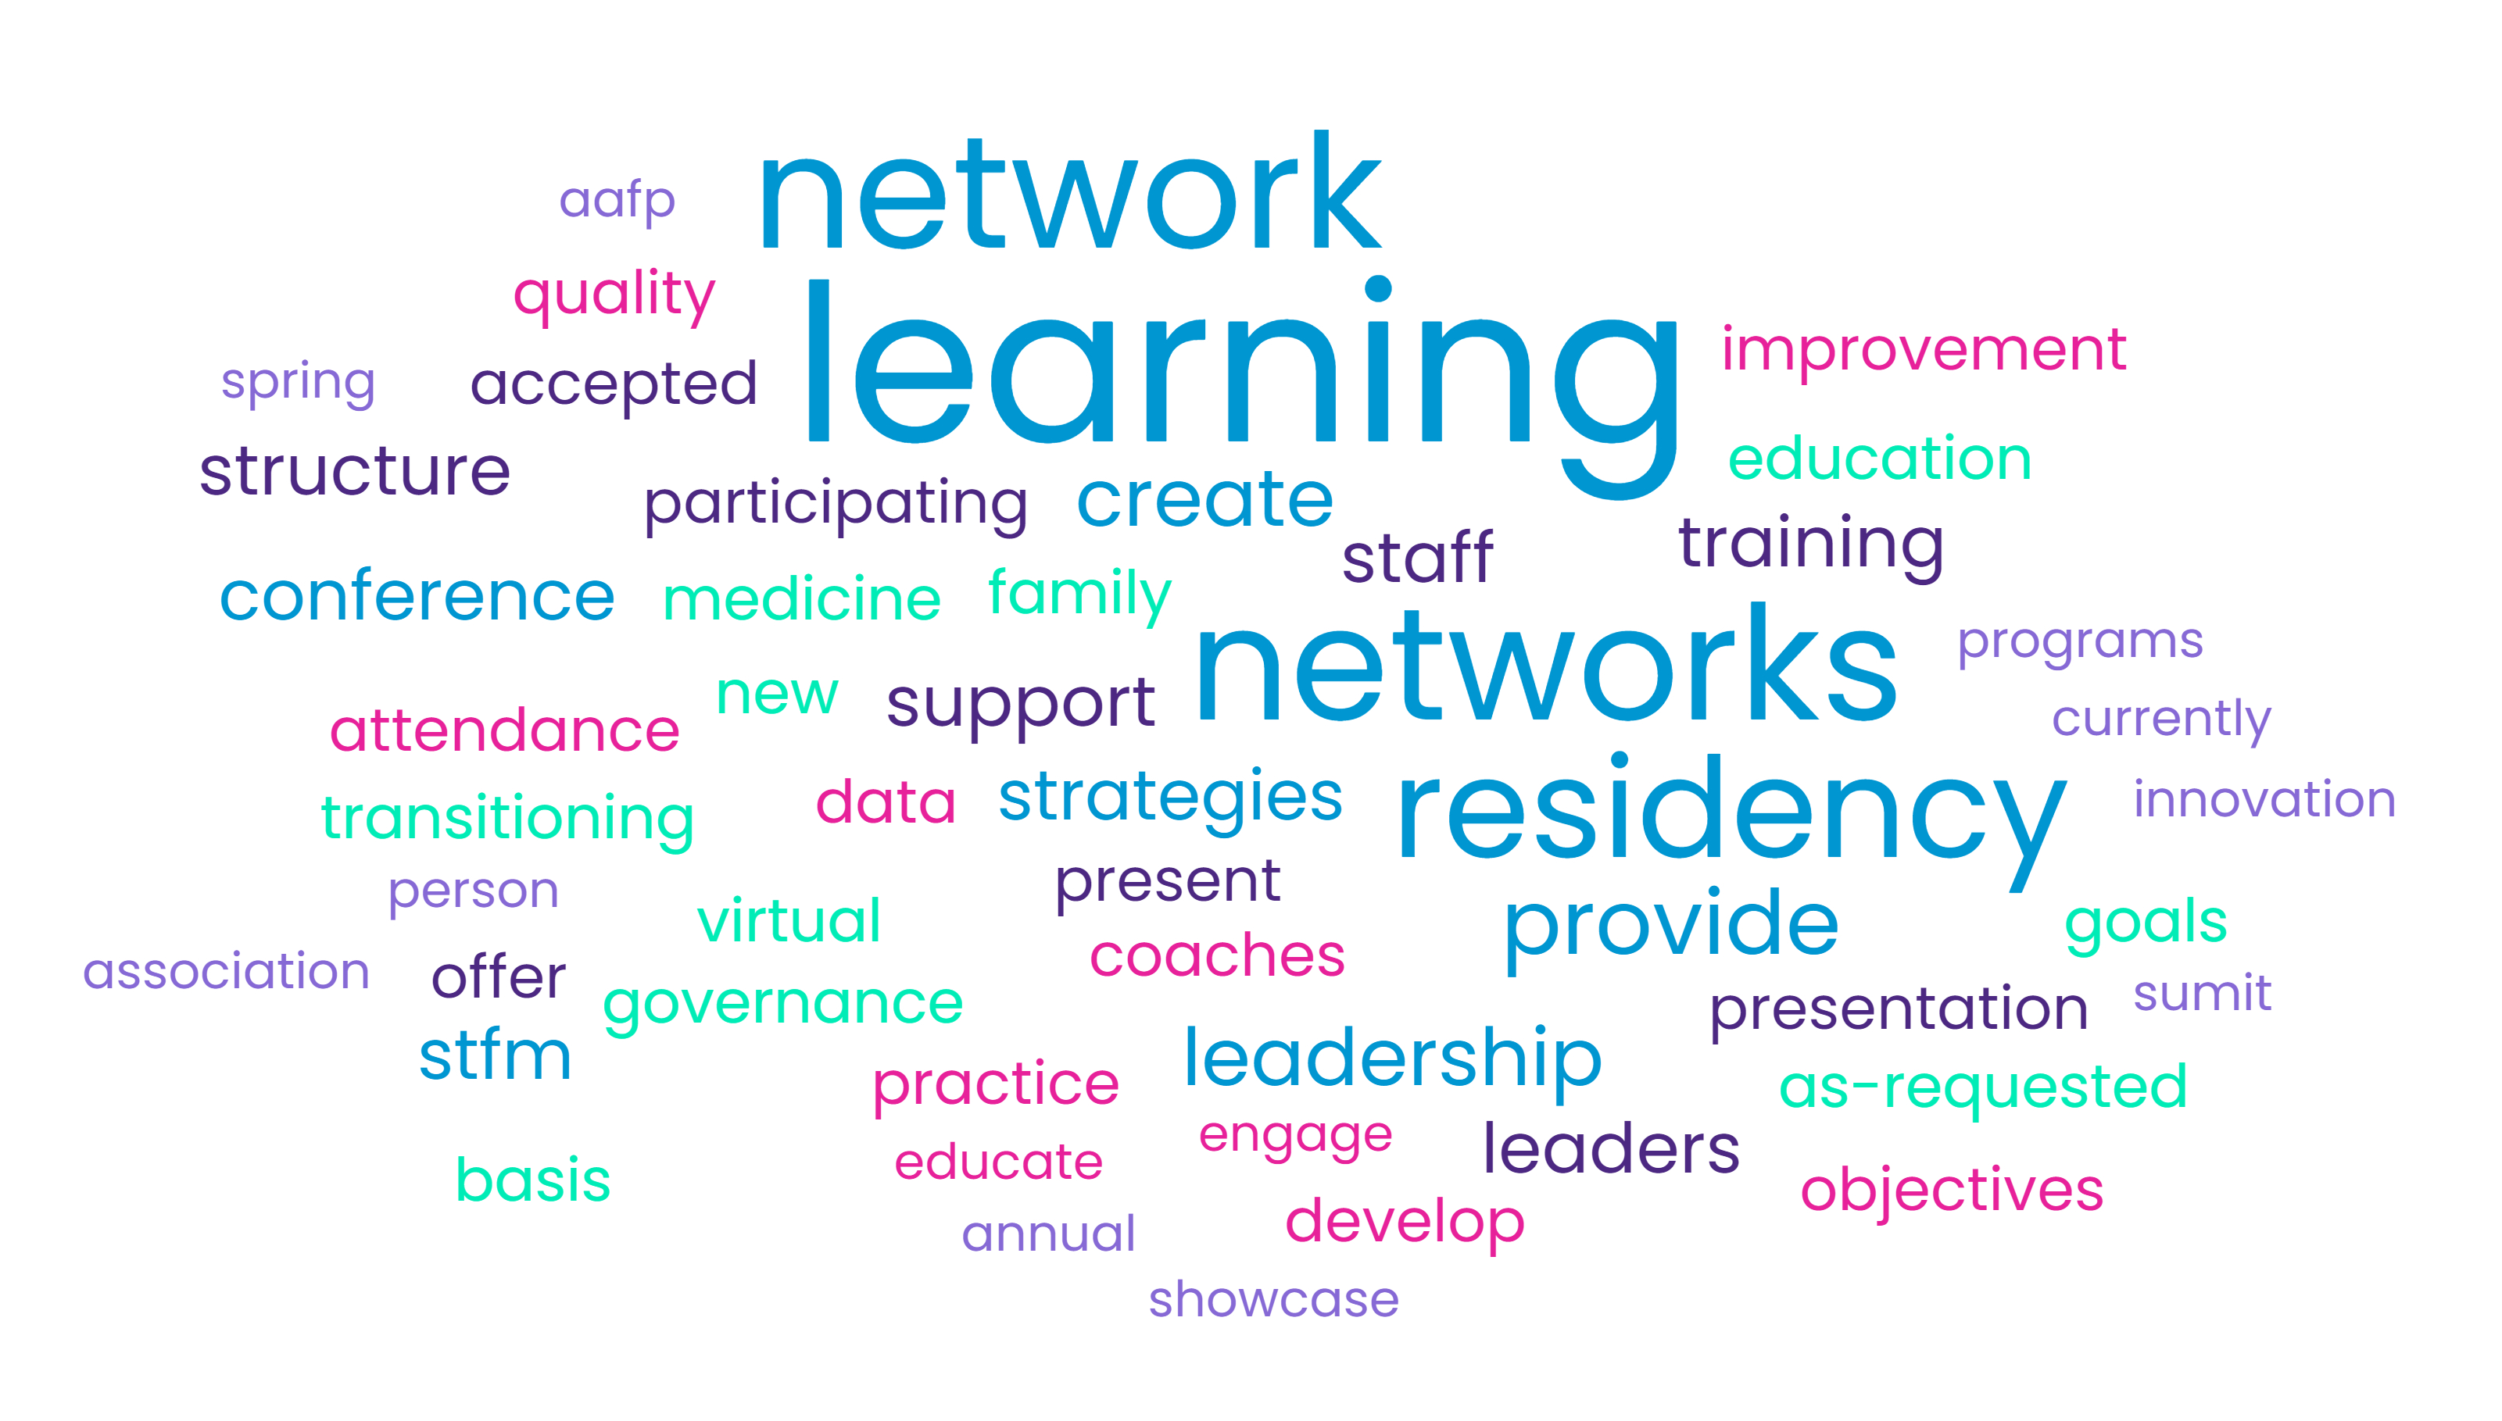
Notes:
The intent of this work is to create a foundation of residency learning networks that will be self-sustaining. By the end of this project, 40 program directors/assistant program directors/faculty will have received in-person training on how to lead residency learning networks. And the online resources developed through this project will be reviewed and updated periodically by our GME Committee.

Slide 10
Questions? Thoughts?
Notes:
Anything we missed?

