Slide 1

Legislative Solutions for the Primary Care Crisis: Rejecting Incrementalism
Massachusetts Primary Care For You
PC4YOU.org
Wayne Altman, MD, FAAFP
Professor of Family Medicine and Community Health, UMass Chan
Founder, MA Primary Care Alliance for Patients (MAPCAP)
President-Elect, Massachusetts Academy of Family Physicians
President, Family Practice Group, Sagov Center for Family Medicine
Wayne Altman, MD, FAAFP
Professor & Chair of Family Medicine, Tufts University SOM
Founder, MA Primary Care Alliance for Patients (MAPCAP)

Slide 2
MAPCAP
MA Primary Care Alliance for Patients
  MMS (March 2019): PC Transformers
  Primary Care Collaborative (PCC) in Washington DC
  Health Policy Commission meetings
  Governor Baker Proposed 30% increase in PC Investment (Nov 2019)
  COVID-19 Pandemic
  Proposal for doubling Primary Care Investment AND replacing FFS with a prospective monthly PC payment
  200 signatures: CEOs, Deans, diverse stakeholders, PCPs
  Task Force → Working Groups (PMPM, Risk, Quality, Employers)
  Legislative Solution: PC4You (S.750)

Slide 3
2021 NASEM Report
PC4YOU is exactly in line with the 2021 NASEM Report which calls for…
- Double Primary Care Investment
- Prospective Monthly Payment as the Predominant PC Reimbursement
- Primary Care as a public good for every resident of Massachusetts
Medicare for All → Primary Care For All & Direct Primary Care for all

Slide 4
A Dire Diagnosis:
The Declining Health of Primary Care in Massachusetts and the Urgent Need for Action
A Special Report on Primary Care Workforce, Access, and Spending Trends
January 2025

Slide 5
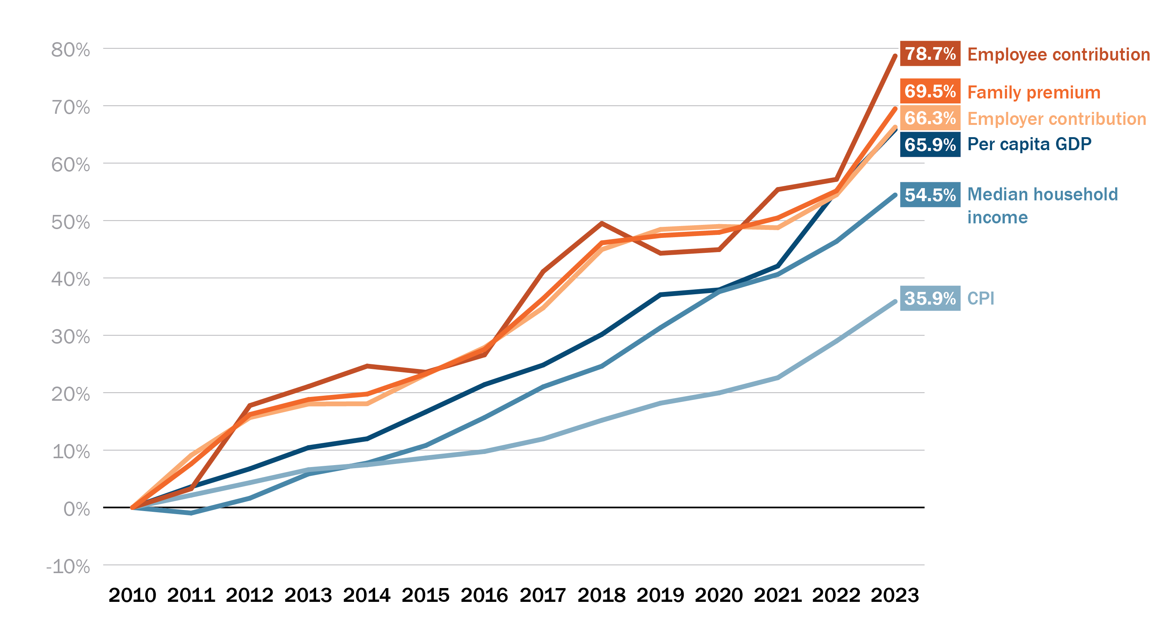
The challenge: In Massachusetts, the growth in health care costs far exceeds increases in income or general inflation, resulting in less affordable and accessible care.
Cumulative growth since 2010 of various health care and economic indicators in Massachusetts
Sources: Agency for Healthcare Research and Quality, Medical Expenditure Panel Survey, American Community Survey, and Bureau of Labor Statistics

Slide 6

The Burning Platform(s)
1. Primary Care access is abysmal.
2. The exorbitant cost of healthcare is devastating to individuals, families, and businesses ¹
3. Fee For Service incentivizes volume rather than value which hurts both patients (convenience) and clinicians (burnout)
4. Our current healthcare system creates large inequities
5. The exodus of PCPs to DPC/Concierge is following the BH model, furthering inequities ²
6. Inadequate Primary Care Pipeline ³
¹ Bodenheimer, 2005
² Shi et al., 2005
³ Bebinger et al., 2020
Notes:
1. Bodenheimer T. High and rising health care costs. Part 1: seeking an explanation. Ann Intern Med. 2005;142(10):847-854.
2. Shi L, Macinko J, Starfield B, Politzer R, Xu J. Primary care, race, and mortality in US states. Soc Sci Med. 2005;61(1):65-75.
3. Bebinger M. Close, Sell, Consolidate? Tough Prognosis For Some Massachusetts Health Care Providers. wbur. https://www.wbur.org/commonhealth/2020/06/11/mass-health-care-providers-close-coronavirus. Published 2020.

Slide 7
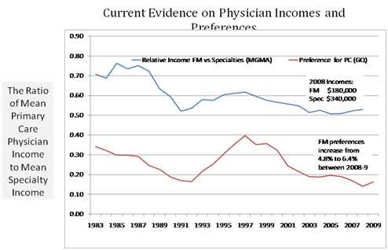
⁴ Kruse, 2013
Notes:
4. Kruse J. Income ratio and medical student specialty choice: the primary importance of the ratio of mean primary care physician income to mean consulting specialist income. Fam Med. 2013;45(4):281-283.

Slide 8
Primary Care Pipeline
Fix the Job for current PCPs
Fix the Job & Fix the Pay for medical students and residents

Slide 9
Primary Care Access Crisis
> 1/3 of the MA Primary Care Docs are over 60 ⁵
PCPs are…
  Retiring
  Retiring early
  Leaving the profession
  Decreasing their hours
  Shifting to DPC or Concierge
⁵ CHIA, 2023
Notes:
5. Center for Health Information and Analysis. Massachusetts Primary Care Dashboard: 2023 Edition. Published August 2023. Accessed April 9, 2025. https://www.chiamass.gov/assets/docs/r/pubs/2023/MA-PC-Dashboard-2023.pdf

Slide 10
Primary Care Access Crisis
Clinicians leaving or decreasing hours
Leaving behind the same workload for a shrinking workforce
Increased burnout

Slide 11
危 机
Crisis

Slide 12
Danger
危
Opportunity
机

Slide 13
MA Primary Care for You (PC4YOU)
GOALS
1. Improve Population Health
2. Increase Health Equity
3. Decrease overall cost of healthcare
Primary Care Triple Superpower
OBJECTIVES
1. Double Primary Care Investment
2. Create a Prospective Monthly Payment for Primary Care, instead of FFS
3. Remove copays and deductibles from PC
4. Financially incentivize PC Transformation
5. Extricate PC from Health Insurance
6. MA Primary Care Task Force

Slide 14
Primary Care Task Force
1. Executive Director of the MA Health Policy Commission (Co-chairs Committee)
2. Secretary of HHS (Co-chairs Committee) or designee
3,4. Chairs of Joint Committees on Healthcare Financing (from the Senate and House) or designees
5. Commissioner of Insurance
6. Assistant secretary for MassHealth or a designee
7. Executive director of CHIA or a designee
8. 1 Member from the Massachusetts Medical Society (MMS)
9. 1 member from the MA Primary Care Alliance for Patients (MAPCAP)
10. 1 member from the Mass Academy of Family Physicians (MassAFP)
11. 1 member from the MA Chapter of the American Academy of Pediatrics (MC-AAP)
12. 1 member from the MA Chapter of the American College of Physicians (MA ACP)
13. 1 member from the Massachusetts League of Community Health Centers
14. 1 member from Health Care For All Massachusetts (HCFA)
15. 1 member from Massachusetts Health Quality Partners (MHQP)
16. 1 member from Community Care Collaborative (C3)
17. 1 member from the Massachusetts Association of Physician Assistants (MAPA)
18. 1 member from the Massachusetts Coalition of Nurse Practitioners (MCNP)
19. 1 member from the Massachusetts Association of Health Plans (MAHP)
20. 1 member from Blue Cross Blue Shield of Massachusetts (BCBSMA)
21. 1 member from the Massachusetts Health and Hospital Association (MHA)
22. 1 member from Associated Industries of Massachusetts (AIM)
23. 1 member from Retailers Association of MA (RAM)
24. 1 member from a rural health care practice with expertise in primary care
25. 1member from the MA chapter of the National Association of Social Work with expertise in BH in PC setting

Slide 15
Primary Care Investment Targets
Year 1: 10%
Year 2: 12.5%
Year 3: 15%

Slide 16
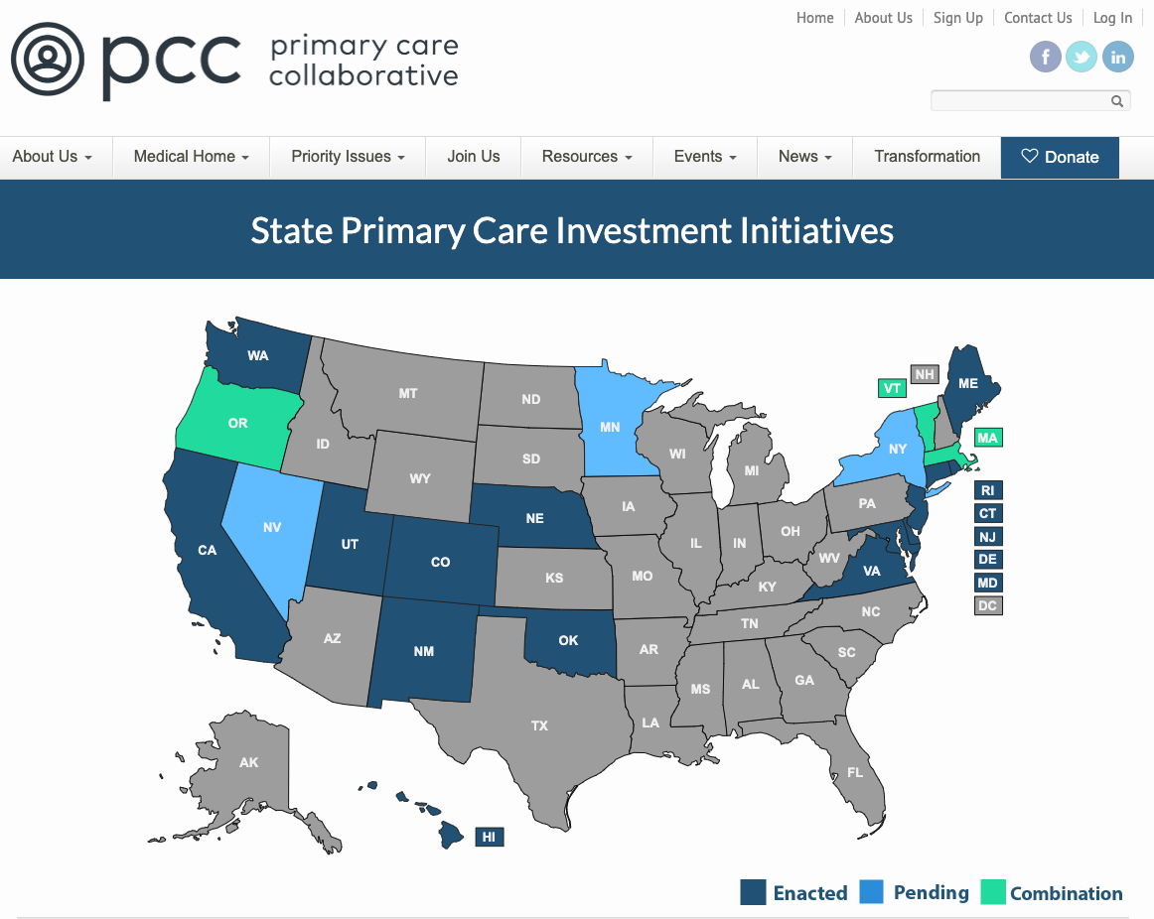
National Momentum
We are not alone
²² PCC, 2025
Notes:
PRACTICING (Oregon, Rhode Island) $ Measuring primary care investment regularly to understand progress $ Implementing care transformation and/or payment innovation vision $ Engaging multiple stakeholders $ Benefiting from meaningful, tested investment requirements/expectations for at least one payer (e.g., contract requirements, regulation, or via care delivery requirements and goals of Medicare demonstration) • IN PROCESS (Colorado, Connecticut, Delaware, Maryland, Massachusetts, Vermont, Washington) $ Measuring primary care investment $ Implementing or beginning to implement care transformation and/or payment innovation vision $ Engaging multiple stakeholders $ Implementing targets/requirements for at least one payer (e.g., legislation/regulation, executive order, payer memorandum of understanding, or MOU/commitment to commit); however, targets/ requirements have not yet been tested • GETTING STARTED (Maine, New Mexico, Utah) $ Communicating interest in increasing primary care investment and may be measuring it $ Developing care transformation and/or payment innovation vision $ Organizing stakeholders to develop target/ requirement • ASPIRATIONAL (Nebraska, New Jersey, Pennsylvania, Virginia, West Virginia) $ Stakeholders share interest in increasing primary care investment and may be measuring it
22. https://www.pcpcc.org/primary-care-investment/legislation/map

Slide 17

MA PC4You Primary Care Transformers
Integrated behavioral health
Addiction treatment
Medical interpreter services
Medical scribes
Care management
Health coaches
Home care
Group visits
Population health
Community health workers
Patient advisory group
Collaboration with pharmacists
Investments in SDoH
Telehealth
Extended availability
Advanced Care Planning
Oral Health
Hosting Learners
Walk In Availability
Accessibility

Slide 18
MassHealth 1115 Waiver
New 1115 waiver began 4/1/2023
Five overarching goals (consistent with PC4You) ²⁹
  Value-Based Care
  Primary Care, Behavioral Health, Children
  Health Equity
  Sustainable mechanism to fund safety net
  Simplify system, including behavioral health
MassHealth waiver to be used as a guide by the Primary Care Task Force to inform processes on tiering, quality, and risk
²⁹ MA HHS, 2023
Notes:
29. Executive Office of Health and Human Services. MassHealth Section 1115 Demonstration Amendment Request. Published May 3, 2024. Accessed April 9, 2025.

Slide 19
Create a Predictable Prospective Payment Model
Proposed Approach
Monthly
“Add On” Payment
Total Monthly Prospective Payment
Monthly Baseline Payment
ADJUSTED FOR
Based on blend of historical spending per patient and market average
Transformers Adopted
Quality of Care Provided
Medical and Social Risk of Patient Panel

Slide 20
Quality Measurement/P4P
Establish a menu of 12 Quality Measures
  Must be appropriate for a primary care setting
  Must be evidence that the implementation of these measures improves health
  Must be patient-centered
Choose six measures from this menu of 12
  At least two of the five measures must be based on patient experience
    Collaboration
    Access
    new ABFM Measures based on continuity and comprehensiveness
  One of those two measures may be PCPCM ^{30, 31}
Consider collaborating with the EOHHS Quality Measure Alignment Task Force
Work toward Standardizing measures across MassHealth and commercial payers
³⁰ Etz et al., 2012
³¹ Ronis et al, 2012
Notes:
Etz RS, Dickinson LM, McDaniel R, et al. A new comprehensive measure of high-value aspects of primary care. Ann Fam Med. 2019;17(3):221-230. doi:10.1370/afm.2393.
Ronis SD, Westphaln KK, Kleinman LC, Zyzanski SJ, Stange KC. Performance of the Person Centered Primary Care Measure in Pediatric Continuity Clinic. Acad Pediatr. 2021;21(6):1077-1083. doi:10.1016/j.acap.2020.12.006

Slide 21
Risk and SDOH
Risk formula to be established by the PC Council with the goals of increasing fairness and equity; ³¹ plus limiting opportunities for gaming and cherry picking.
Age/Sex
  Removes gaming and administrative burden³²
  Adopted by BCBS in some of their new products
Neighborhood Stress Score (NSS)
  Accounts for social determinants of health³³
  Builds on MassHealth ACO model ³⁴
  Similar models being used in UK, New Zealand
PCALS (Primary Care Activity Levels): 1, 2 PLUS Diagnoses and Medications
³² Iezzoni, 1997
³³ LaPointe , 2019
³⁴ Ash et al, 2017
³⁵ Huffstetler et al., 2019
Notes:
32. Iezzoni LI. Risk Adjustment for Measuring Health Care Outcomes. Vol 2. Health Administration Press Chicago; 1997.
33. LaPointe J. Hospital Upcoding Behind Increase in Inpatient Spending in MA. Revcycle Intelligence. https://revcycleintelligence.com/news/hospital-upcoding-behind-increase-in-inpatient-spending-in-ma. Published 2019.
34. Ash AS, Mick EO, Ellis RP, Kiefe CI, Allison JJ, Clark MA. Social determinants of health in managed care payment formulas. JAMA Intern Med. 2017;177(10):1424-1430.
35. Huffstetler AN, Phillips Jr RL. Payment structures that support social care integration with clinical care: social deprivation indices and novel payment models. Am J Prev Med. 2019;57(6):S82-S88

Slide 22
Who Benefits?
Practices that opt in to PC4YOU receive a prospective monthly payment for their commercial patients from the Primary Care Stabilization Fund
Benefits all the patients in the practice (Transformers)

Slide 23
Health Insurance Coverage in MA
Data from Kaiser Family Foundation (2023)
Massachusetts Population
7.136 Million
Notes:
Massachusetts Population 7.136 Million in 2024
Commercial Coverage: 55% (about 4 million people)
About 60% of which are self-funded/ERISA/employer-based (about 2.4M people)
About 40% fully funded (about 1.6M people)
Medicaid: 24% (about 2 million people)
Medicare: 14% (about 1 million people)
Uninsured 3% (about 200,000 people)
Military: 0.4% (about 30,000 people)
2023 data from the Kaiser Family Foundation

Slide 24
Massachusetts Primary Care Trust (administered by HPC)
Better outcomes and experience
Primary care practices and Health Systems who opt into PC4You
Patients
$$$
Massachusetts
Primary Care Stabilization Fund (Commercial only/Optional)
Attest or demonstrate PC Transformers
$$$
Assessment
Use of assessments does not exclude ERISA plan participation.
Self-insured plans would choose this model as they would not want to pay twice for primary care.
Commercial insurers
Large Hospital Systems
Pharma
Urgent Care

Slide 25

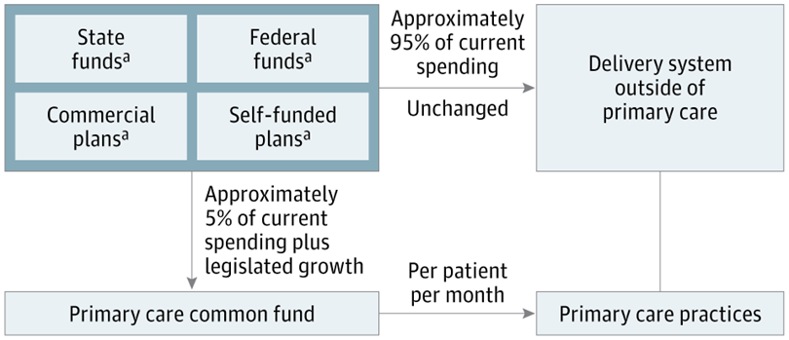
(May 20, 2026)
Solutions
Calls from Policymakers
Federalism/ERISA
Pluralism/Complexity
Advantages
Consumer freedom
State choice
Burden reduction
Compromise

Slide 26
Primary Care Stabilization Fund
Does insurance belong with Primary Care?
Includes ERISA plans/Employer-based/Self-Funded plans (unlike RI, DE)
Only viable way to address market power differences/rate inequities
Decreased administrative burden in practices
Allows for resources to be shifted into patient care/The Transformers
Commercial payers save money by not having to administer Primary Care

Slide 27
A Common Fund for the Common Good
Universal, state-administered single payer program covering primary care services
Primary care coverage carved out from the remaining health insurance system
Private and public health plans direct a specified portion of their premiums/budgets to finance a common fund for the primary care public utility
Budget for common fund statutorily indexed to state’s PC spend target (e.g., 15%)
All state residents eligible for universal primary care coverage
Essentially functions as state-sponsored direct primary care for all

Slide 28
Albert Einstein
“The significant problems we face cannot be solved at the same level of thinking we were at when we created them."

Slide 29
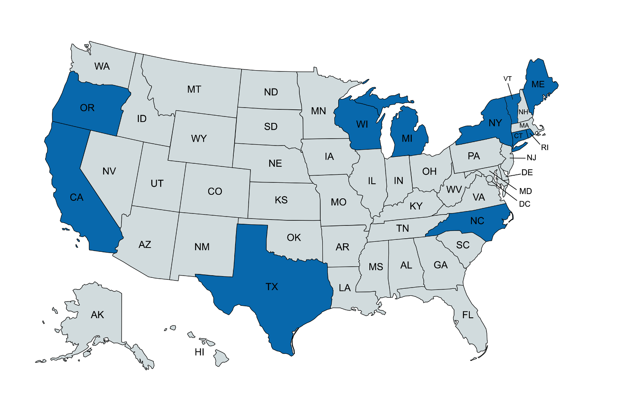
MAP:

Slide 30
How to ensure that the PC4You $$$ actually gets to clinicians/practices
95% of Primary Care $$$ flowing into an organization from PC4You required to go to Primary Care practices (as opposed to health systems/IPAs/ACOs)
Enforced through Audits by HPC
  Audits random for small practices/mandatory for large systems
  Practices/Systems not in compliance will be forced to rectify the identified discrepancy on the audit.
  If still not compliant, they will be forced to pay a significant penalty.

Slide 31
Increase Health Equity
  PC4YOU increases health equity by…
  Expanding access to Primary Care
  Eliminating cost sharing for patients
  Investing in transformers proven to improve equity
  Use social risk adjustment to focus a greater proportion of new investment on historically under- resourced communities
  Increased rate equity through the Primary Care Stabilization Fund
Notes:
Option 2

Slide 32

How do we pay for this?

Slide 33
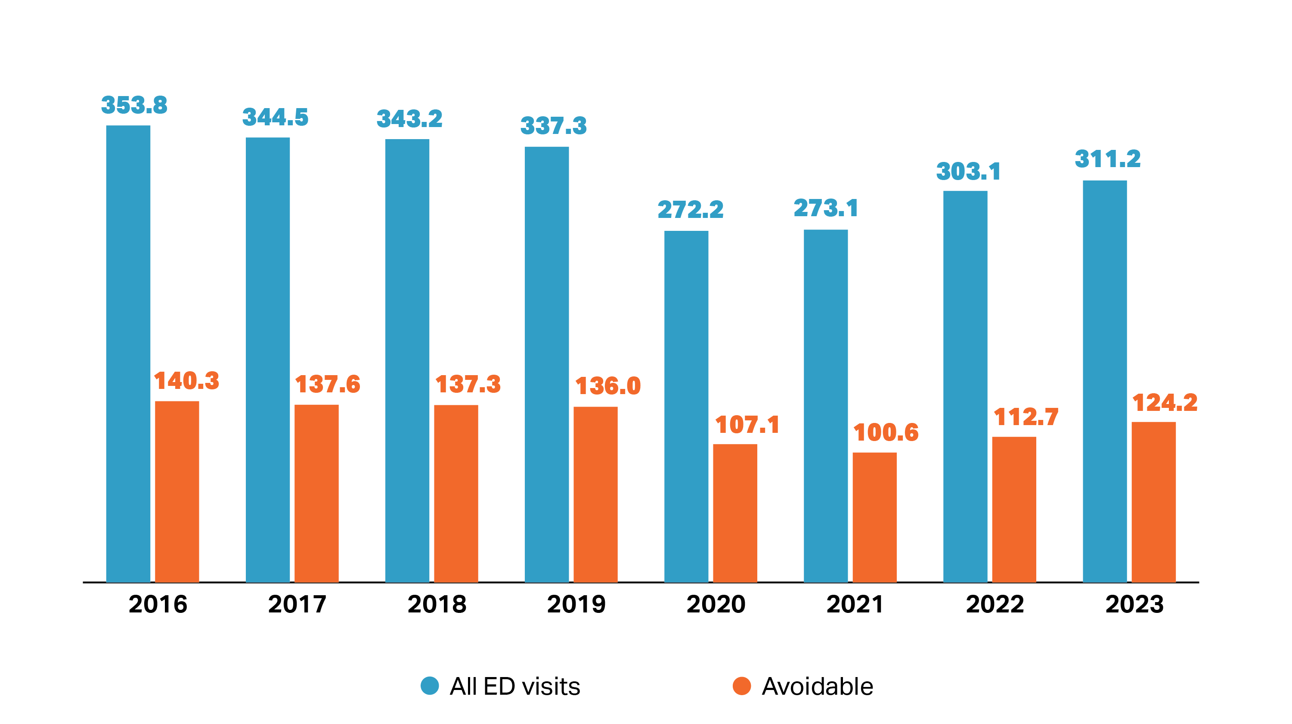
Roughly 40% of emergency department visits continue to be for conditions that could have been treated in a primary care setting or prevented with timely primary care.
All ED visits and potentially avoidable ED visits per 1,000 residents, 2016-2023
A 2023 survey of Massachusetts residents found that of those who had an ED visit for a nonemergency condition, 66.1% sought care in the ED because they were unable to get an appointment at a doctor's office or clinic as soon as needed.¹
There are persistent disparities in potentially avoidable ED use. As of 2023, 47.9% of Black non-Hispanic residents and 51.3% of Hispanic residents reported that their most recent ED visit was for a non-emergency condition, compared to 26.5% of White non-Hispanic residents.²
Notes: 'Avoidable ED visits are based on the Billings algorithm, which classifies an ED visit into the following categories: Emergent - ED care needed and not avoidable; Emergent - ED care needed but avoidable; Emergent - primary care treatable; and Non-emergent - primary care treatable. "Avoidable" is defined here as ED visits that were emergent - primary care treatable or non-emergent - primary care treatable. Behavioral health ED visits were identified based on a principal diagnosis related to mental health and/or substance use disorder using the Clinical Classifications Revised Software (CCSR) diagnostic classifications. To improve classification rate, diagnosis codes unclassified by the Billings algorithm were truncated and shortened codes were re-classified. Please see the technical appendix for additional details.
Sources: 'HPC analysis of Center for Health Information and Analysis Emergency Department Database, CY2016 – 2022; 1 Center for Health Information and Analysis, Findings from the 2023 Massachusetts Health Insurance Survey, 2024.; 2 Center for Health Information and Analysis. Primary Care in Massachusetts Databook. January 2023.

Slide 34

Simulation Accounting for the Evidence of the Impact of Increasing Investment of Primary Care
A study by the Integrated Healthcare Association (IHA) and commissioned by the California Health Care Foundation (CHCF) found increased primary care investment results in better outcomes.
A study of 80% of Californians with commercial HMO coverage found higher spending on primary care was associated with….
  Better performance on quality and patient experience measures
  Lower hospital and emergency department use
  Lower total cost of care
⁴⁵ Yanagihara et al., 2022
Notes:
45. Investing in Primary Care: Why it matters for California's with Commercial Coverage. 2022. Dolores Yanagihara and Ann Hwang.

Slide 35
Achieving Return on Investment
Scenario 1 assumes the lowest participation. It had the lowest initial cost but also the lowest ROI. Scenario 2 assumes the highest participation. It had the highest initial cost and the highest ROI.
NET COST / SAVINGS
ROI begins after 4 years
in each scenario
Notes:
Both scenarios assumed return on investment would gradually increase. All were estimated to cover the cost of the program after Year 4 and all were projected to reach savings of 4.5% of total medical expense in Year 5 for the population they served.

Slide 36
What about the first four years?
Large Hospital Systems: high functioning Primary Care decreases the number of low value patients we send to hospitals/, yielding a higher % of complicated and high value patients for them (“higher contribution margin”)
Commercial Payers: how much can they continue to raise premiums?
Pharma in MA: needs Primary Care to prescribe their medications
Imaging Companies
Urgent Care copays

Slide 37
Projections over the Long Term
The graph below illustrates the assumptions on the previous slides to show what the potential cost savings could look like over 15 years.
NET COST / SAVINGS
Return on Investment begins after 4 years
Notes:
Both scenarios assumed return on investment would gradually increase. All were estimated to cover the cost of the program after Year 4 and all were projected to reach savings of 4.5% of total medical expense in Year 5 for the population they served.

Slide 38
Estimate of Savings Distribution
The pie chart to the left shows how savings might be distributed across stakeholders.
These estimates reflect the current market composition including percent of providers participating in shared savings arrangements and percent of individuals covered by self-insured and fully-insured plans
Notes:
Insurer hospital payments would reflect payments for services rendered to fully-insured and self-insured members.
Hospital price growth approach here addresses lessons learned from similar policies in other states by not pegging directly to inflation and by not limiting price growth for historically underfunded hospitals and health systems.

Slide 39
Savings for Consumers
Consumers pay for health care in many ways including through premiums paid to health insurance companies, out-of-pocket costs at the doctor’s office, lost wages spent by their employer on health care costs and taxes.
Consumers would not pay out of pocket for primary care under PC4You.
Modeling focused on savings generated from lower premiums. It estimated savings of nearly $341 million over 15 years for Massachusetts consumers.

Slide 40
Savings for Employers
Many employers pay for the health care costs of their employees.
Some employers “self-insure” their employees’ health care benefits. In these scenarios, employers are responsible for the full cost of their employees’ health care, so they directly benefit from lower costs.
Modeling focused on savings from lower health care costs for self-insured employers in Massachusetts. It estimated savings of nearly $625 million over 15 years.

Slide 41
Savings for Health Plans
Some employers and individuals pay premiums to health plans to cover the health care costs of their employees and families.
These health plans would also benefit from the lower health care costs generated by PC4You.
Modeling estimated savings of nearly $398 million over 15 years for Massachusetts health plans.

Slide 42
Shared Savings for Health Systems/Hospitals
A growing number of health systems and hospitals have been participating in programs with insurance companies that aim to improve health care value.
Under these programs, if patients’ health improves and spending decreases, the health systems and hospitals share in the savings.
These improvements in health and lower spending would be more likely to occur under PC4You.
The modeling estimates that MA hospitals/health systems would earn $341 million over 15 years through shared savings.

Slide 43
31 Endorsements
Massachusetts Medical Society (MMS)
UMASS Memorial Health Care
Mass League of Community Health Centers
Community Care Cooperative (C3)
American Academy of Family Physicians (AAFP)
Mass Academy of Family Physicians (MassAFP)
MA Chapter American Academy of Pediatrics (MCAAP)
MA Chapter American College of Physicians (MA ACP)
Society of General Internal Medicine (SGIM)
The Arc of Massachusetts
Easter Seals of Massachusetts
MA Society of Addiction Medicine (MASAM)
NEMA (New England Medical Association)
MA Assoc. for Mental Health (MAMH)
Moms Rising
Families USA
Inst. for Healthcare Improvement (IHI)
Health Care For All (HCFA)
MA Association of PAs (MAPA)
MA Coalition of NPs (MCNP)
AFT Massachusetts (Teachers Union)
Doctors Council: MGB PCP Union
Committee of Interns and Residents (CIR)
Ask Nurses and Doctors (AND)
Boston Community Pediatrics
My Brothers Keeper (MBK) Cambridge
Boston Public Health Commission
Worcester Board of Health
The City of Springfield, MA
The City of Cambridge, MA
The City of Newton, MA

Slide 44
3 Primary Care Bills
All imperfect and incomplete
S.867 Senator Friedman: CHCs and BH
Senate Ways and Means → Senate Floor for a vote
H.1370 Representative Haggerty: PCSF
Healthcare Financing Committee → House Ways and Means
H.2537 Representative Schwartz: Medicaid GME
Healthcare Financing Committee → House Ways and Means

Slide 45
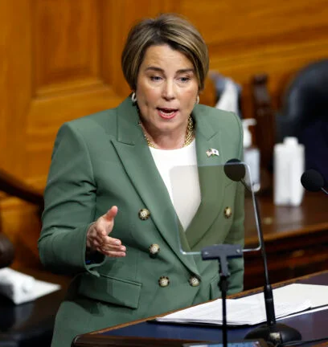
In her January 2025 state of the Commonwealth address, Governor Maura Healey called for reforms to strengthen primary care in Massachusetts.
Patients are paying more than ever for premiums and out-of-pocket costs. Often, it’s hard just to get an appointment. It’s really frustrating. It’s also unacceptable. It has to change.
I am directing my Administration to shift health care resources to the front lines. And by that, I mean primary care.
We’ll drive career training pipelines to grow the workforce. I want a whole army of primary care providers out there, so when you call for an appointment, you’ll get one. You’ll get the affordable care you need, where and when you need it.”
—Governor Maura Healey

Slide 46
Current System
Current System
PC4You
Health
Equity
Profit/Margin

Slide 47
Current System
Current System
PC4You
PC4You
Health
Equity
Profit/Margin

Slide 48
References
1. Bodenheimer T. High and rising health care costs. Part 1: seeking an explanation. Ann Intern Med. 2005;142(10):847-854. doi:10.7326/0003-4819-142-10-200505170-00010
2. Shi L, Macinko J, Starfield B, Politzer R, Xu J. Primary care, race, and mortality in US states. Soc Sci Med. 2005;61(1):65-75. doi:10.1016/j.socscimed.2004.11.056
3. Bebinger M. Close, sell, consolidate? Tough prognosis for some MA health care providers. WBUR. Published June 11, 2020. Accessed April 9, 2025. https://www.wbur.org/commonhealth/2020/06/11/mass-health-care-providers-close-coronavirus
4. Kruse J. Income ratio and medical student specialty choice: the primary importance of the ratio of mean primary care physician income to mean consulting specialist income. Fam Med. 2013;45(4):281-283.
5. Center for Health Information and Analysis. Massachusetts Primary Care Dashboard: 2023 Edition. Published August 2023. Accessed April 9, 2025. https://www.chiamass.gov/assets/docs/r/pubs/2023/MA-PC-Dashboard-2023.pdf
6. Kato D, Ryu H, Matsumoto T, et al. Building primary care in Japan: literature review. J Gen Fam Med. 2019;20(5):170-179. doi:10.1002/jgf2.252
7. Japan plans subscription model to promote primary care. Nikkei Asia. Published July 2, 2023. Accessed April 9, 2025. https://asia.nikkei.com/Business/Health-Care/Japan-plans-subscription-model-to-promote-primary-care
8. More than 1 in 5 Canadians lack access to primary care. News-Medical.net. Published 5/21/24. Accessed 4/9/25. https://www.news-medical.net/news/20240521/More-than-1-in-5-Canadians-lack-access-to-primary-care-research-finds.aspx
9. Lemire F. Leadership and accountability for family medicine. Can Fam Physician. 2018;64(6):480.
10. Government of Canada highlights budget investments to strengthen public health care and support health workers. Health Canada. Published April 3, 2023. Accessed April 9, 2025. https://www.canada.ca/en/health-canada/news/2023/04/government-of-canada-highlights-budget-investments-to-strengthen-public-health-care-and-support-health-workers.html
11. Longitudinal Family Physician (LFP) Payment Model. Govt of British Columbia. Accessed 4/925. https://www2.gov.bc.ca/gov/content/health/practitioner-professional-resources/msp/physicians/longitudinal-family-physician-lfp-payment-model
12. Jaffe, D. H., Shmueli, A., Ben-Yehuda, A., Paltiel, O., Calderon, R., Cohen, A. D., Matz, E., Rosenblum, J. K., Wilf-Miron, R., & Manor, O. (2012). Community healthcare in Israel: quality indicators 2007-2009. Israel journal of health policy research, 1(1), 3. https://doi.org/10.1186/2045-4015-1-3
13. European Commission. State of Health in the EU: Germany Country Health Profile 2021. Published December 2021. Accessed April 9, 2025. https://health.ec.europa.eu/system/files/2021-12/2021_chp_de_english.pdf
14. German healthcare in postpandemic era: Physician insights. McKinsey & Company. Published 6/29/23. Accessed 4/9/25. https://www.mckinsey.com/industries/healthcare/our-insights/german-healthcare-in-the-postpandemic-era-physician-insights
15. Wangler J, Jansky M. How can primary care be secured in the long term? A qualitative study from the perspective of general practitioners in Germany. Eur J Gen Pract. 2023;29(1):2223928. doi:10.1080/13814788.2023.2223928
16. National Health Service. Primary care patient safety strategy. NHS England. Published February 10, 2021. https://www.england.nhs.uk/long-read/primary-care-patient-safety-strategy/. Accessed April 9, 2025.
17. National Health Service. NHS long-term workforce plan. NHS England. Published June 30, 2023. https://www.england.nhs.uk/long-read/nhs-long-term-workforce-plan-2/. Accessed April 9, 2025.
18. Puthucheary J. Capitation funding model will not compromise medical treatment: Janil Puthucheary. The Straits Times. Published March 5, 2023. https://www.straitstimes.com/singapore/capitation-funding-model-will-not-compromise-medical-treatment-janil-puthucheary. Accessed April 9, 2025.
19. Synapxe. National Electronic Health Record (NEHR). Synapxe. https://www.synapxe.sg/healthtech/national-programmes/national-electronic-health-record-nehr. Accessed April 9, 2025.
20. Ministry of Health and Welfare. [Subject of the document in Korean]. Ministry of Health and Welfare. Published March 7, 2025. https://www.mohw.go.kr/board.es?mid=a20401000000&bid=0032&list_no=1480151&act=view. Accessed 4/9/25.
21. Healthcare IT News. Multi-million dollar smart hospital emergency system projects in South Korea and more: Briefs. Healthcare IT News. Published April 5, 2025. https://www.healthcareitnews.com/news/asia/multi-million-dollar-smart-hospital-emergency-system-projects-south-korea-and-more-briefs. Accessed April 9, 2025.
22. Primary Care Collaborative. State Primary Care Investment Legislation Map. Published April 9, 2025. https://www.pcpcc.org/primary-care-investment/legislation/map. Accessed April 9, 2025.
23. Primary Care Collaborative. State Initiatives Map: Rhode Island. Published April 9, 2025. https://thepcc.org/policy/state-investment-hub/state-initiative-map/?_sft_associtated_state=rhode-island. Accessed April 9, 2025.
24. Primary Care Collaborative. State Initiatives Map: Colorado. Published April 9, 2025. https://thepcc.org/policy/state-investment-hub/state-initiative-map/?_sft_associtated_state=colorado. Accessed April 9, 2025.
25. Primary Care Collaborative. State Initiatives Map: Delaware. Published April 9, 2025. https://thepcc.org/policy/state-investment-hub/state-initiative-map/?_sft_associtated_state=deleware. Accessed April 9, 2025.
26. Primary Care Collaborative. State Initiatives Map: California. Published April 9, 2025. https://thepcc.org/policy/state-investment-hub/state-initiative-map/?_sft_associtated_state=california. Accessed April 9, 2025.
27. Primary Care Collaborative. State Initiatives Map: Maryland. Published April 9, 2025. https://thepcc.org/policy/state-investment-hub/state-initiative-map/?_sft_associtated_state=maryland. Accessed April 9, 2025.
28. Primary Care Collaborative. State Initiatives Map: Oregon. Published April 9, 2025. https://thepcc.org/policy/state-investment-hub/state-initiative-map/?_sft_associtated_state=oregon. Accessed April 9, 2025.
29. Executive Office of Health and Human Services. MassHealth Section 1115 Demonstration Amendment Request. Published May 3, 2024. Accessed April 9, 2025.
30. Etz RS, Dickinson LM, McDaniel R, et al. A new comprehensive measure of high-value aspects of primary care. Ann Fam Med. 2019;17(3):221-230. doi:10.1370/afm.2393.
31. Ronis SD, Westphaln KK, Kleinman LC, Zyzanski SJ, Stange KC. Performance of the Person Centered Primary Care Measure in Pediatric Continuity Clinic. Acad Pediatr. 2021;21(6):1077-1083. doi:10.1016/j.acap.2020.12.006
32. Iezzoni LI. Risk Adjustment for Measuring Health Care Outcomes. Vol 2. Chicago, IL: Health Administration Press; 1997.
33. LaPointe J. Hospital upcoding behind increase in inpatient spending in MA. Recycle Intelligence. Published 2019. https://revcycleintelligence.com/news/hospital-upcoding-behind-increase-in-inpatient-spending-in-ma. Accessed 4/9/25.
34. Ash AS, Mick EO, Ellis RP, Kiefe CI, Allison JJ, Clark MA. Social determinants of health in managed care payment formulas. JAMA Intern Med. 2017;177(10):1424-1430.
35. Huffstetler AN, Phillips RL Jr. Payment structures that support social care integration with clinical care: social deprivation indices and novel payment models. Am J Prev Med. 2019;57(6):S82-S88.
36. Kwan BM, Nease DE. The state of the evidence for integrated behavioral health in primary care. In: Integrated Behavioral Health in Primary Care. Springer; 2013:65-98.
37. Wittwer SD. The patient experience with the mental health system. J Manag Care Pharm. 2006;12(2 Suppl A):S21-S23.
38. Dietrich AJ, Oxman TE, Williams JW, et al. Re-engineering systems for the treatment of depression in primary care: cluster randomised controlled trial. BMJ. 2004;329(7466):602.
39. Dea RA. The integration of primary care and behavioral healthcare in Northern California Kaiser-Permanente. Psychiatr Q. 2000;71(1):17-29.
40. McNellis RJ, Genevro JL, Meyers DS. Lessons learned from the study of primary care transformation. Ann Fam Med. 2013;11(Suppl 1):S1-S5.
41. Adashi EY, Geiger HJ, Fine MD. Health care reform and primary care—the growing importance of the community health center. N Engl J Med. 2010;362(22):2047-2050.
42. Song Z, Rose S, Safran DG, Landon BE, Day MP, Chernew ME. Changes in health care spending and quality 4 years into global payment. N Engl J Med. 2014;371(18):1723-1731.
43. PwC Health Research Institute. ROI for primary care: Building the dream team. Published 2016. https://www.pwc.com/healthresearchinstitute. Accessed April 9, 2025.
44. Patient Centered Primary Care Collaborative. 2017 Annual Report. Robert Graham Center, funded by Millbank. Published 2017. Accessed April 9, 2025.
45. Yanagihara D, Hwang A. Investing in primary care: Why it matters for California's with commercial coverage. Published 2022. Accessed April 9, 2025.
46. Center for Health Information and Analysis (CHIA). Primary care and behavioral health care (PCBH) expenditures. Published 2021. Accessed April 9, 2025.
47. Tufts Medicine. Internal analysis of primary care spend, 2024. Accessed April 9, 2025.

Slide 49

Primary Care For You
PC4YOU.org
Questions?
Wayne Altman, MD
wayne.altman9@gmail.com
Kevin Grumbach, MD
Kevin.Grumbach@ucsf.edu

